Slide 1
The Separation Of Powers
Legislature, Executive and Judiciary

Slide 2
Activities
Outline the role of each of the following arms of
government, and provide an example of each:
a. legislative arm
b. executive arm
c. judicial arm.
Why is the separation of powers important?

Slide 3
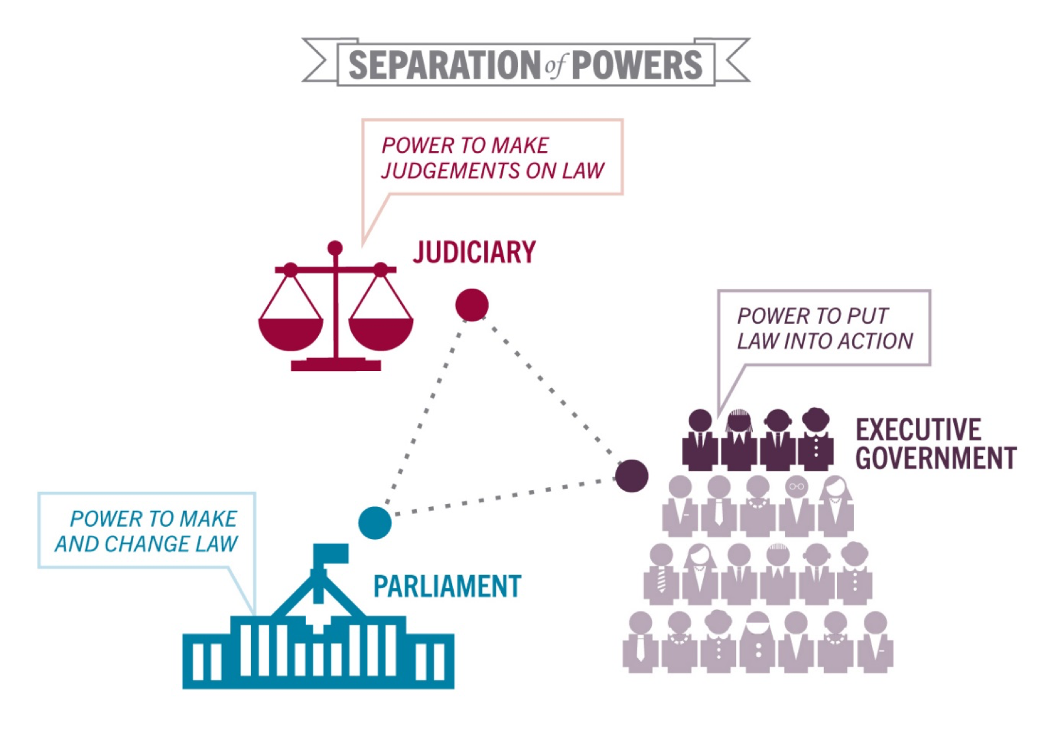
‘The separation of powers is an important safeguard of our rights and freedoms in Australia.’ Do you agree or disagree with this statement? Give reasons for your answer

Slide 4
The separation of powers
At both the federal and state levels, the functions of government are not all concentrated in the parliament.
The Australian Constitution supports the idea of the separation of powers to allow for three arms of government:
Executive
Legislature
Judiciary

Slide 5
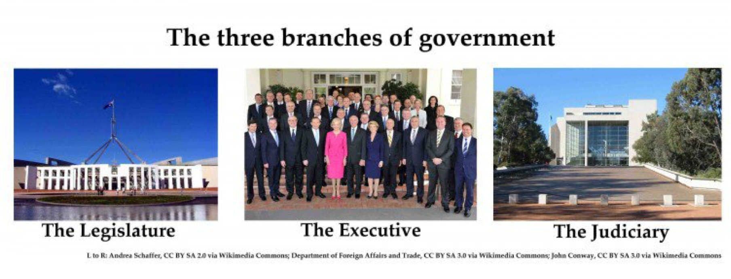

Slide 6
The Legislative Arm
This is the parliament, which has the power to make new laws and to change or repeal existing laws.
It consists of two separate ‘houses’ — the House of Representatives and the Senate — together with the Governor-General as the representative of the Queen.
To become law, a Bill must be debated and voted on by both houses of parliament, and then approved by the Governor-General.
Extension: What is a republic? Should Australia become one?

Slide 7
The Executive Arm
The arm of the government responsible for developing laws.
These are members of parliament who have special responsibility for particular areas of government.
For example, the minister for defence is responsible for administering all laws that relate to the defence forces; Public servants and other government employees are part of the executive arm of government.
Extension: What minister would you like to be and why?

Slide 8
The Judicial Arm
This includes the judiciary and the courts, which are responsible for enforcing the law and settling disputes that might arise under the law.
The courts can also ensure that the law is applied fairly and equally to everyone, so they are a safeguard for our rights and freedoms.
The High Court of Australia has the power to interpret and enforce the Constitution. It can make sure that neither the legislative arm nor the executive arm acts in a way that is outside the constitutional powers of that arm.
http://www.scootle.edu.au/ec/viewing/R10292/index.html
Extension: How much power do you think a high court judge has?

Slide 9
Why do we have the separation of powers?
Write down the think extension. As you finish your notes, write your answer.
The separation of powers provides a system of checks and balances on the power of government. This works in the following ways
Members of parliament can make laws but have to face elections on a regular basis. If laws prove to be unpopular or unfair, the people can vote for new and different members to replace them.

Slide 10
Why do we have the separation of powers?
An independent judiciary has the power to ensure that parliament and the executive are acting within the limits of the Constitution. This is a way of protecting individual freedoms. The High Court can declare any law invalid if it is contrary to the Constitution.
Government ministers are all members of parliament, and are individually accountable to parliament. They are required to answer questions in parliament about actions they take as part of their executive role.

Slide 11
Why do we have the separation of powers?
Government ministers have to gain the approval of a majority of both houses of parliament if they want to bring in any new laws. If they cannot convince enough members, the law will not be passed.

Slide 12
Think
‘The separation of powers is an important safeguard of our rights and freedoms in Australia.’ Do you agree or disagree with this statement? Give reasons for your answer

